Slide 1

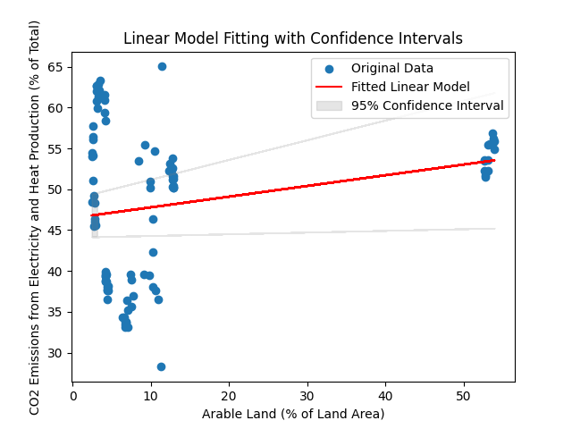
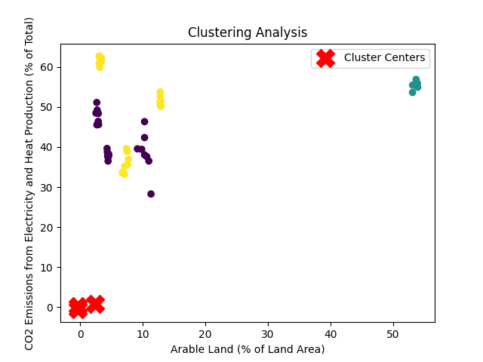
Clustering Analysis and Linear Model Fitting
Abstract
In order to investigate the relationship between the percentage of arable land and CO2 emissions from the production of heat and electricity across national borders, this analysis combines clustering and linear modelling techniques. The study uses a fitted linear model to anticipate emissions for the years 2024, 2025, and 2026 as well as to visualise cluster patterns and identify cluster centres.
Introduction
This analysis aims to investigate the relationship between the use of agricultural land and CO2 emissions from the generation of heat and electricity in various nations. In order to find patterns in the data, clustering analysis is used, and linear model fitting is used to determine how particular variables relate to one another.
Data Pre-processing
Modelling
Loading the dataset from the supplied CSV file and translating pertinent columns to numeric representation constitute the first stage. The chosen numerical columns deal with access to electricity, the use of agricultural land, methane emissions from agriculture, the percentage of arable land, and CO2 emissions from the generation of heat and power. The appropriate rows are eliminated in order to address any missing values.
4.1 Model Linear
The percentage of arable land and CO2 emissions from the production of heat and electricity are examined using a linear model. Rows containing missing values are removed from the analysis and the chosen variables are extracted from the dataset.
4.2 Ranges of Confidence in
To provide light on the uncertainty around the model, confidence intervals are computed, and the fitted linear model parameters are determined.
Clustering analysis
3.1 Clustering Analysis
3.1 Bringing Things into Line
To guarantee that every variable contributes equally to the clustering process, the numerical data is normalised. In this stage, the data are normalised by dividing by the standard deviation and removing the mean.
3.2 Clustering using K-Means
Using three clusters, the K-Means method groups countries according to their normalised data. The performance of the clustering is assessed using the silhouette score. A higher silhouette score denotes more clearly defined clusters. The silhouette score measures how well-separated the clusters are.
3.3 Findings
The resultant silhouette score is 0.60.An improved definition of the division between clusters is implied by a higher silhouette score.
Predictions:
year | Predictions
2024 | 311.872
2025 | 312.003
2026 | 312.134
Conclusion
The utilisation of clustering analysis facilitates a more comprehensive comprehension of country groups by exposing unique patterns in the correlation between the chosen variables. With a focus on the inherent uncertainty in the model, the linear model fitting, and visualisation shed light on the connection between arable land and CO2 emissions. The purpose of this study is to help stakeholders make decisions that are well-informed by using the patterns and relationships found in the dataset. A closer examination and improvement of the analysis can be required in light of certain research questions or goals.
Datasource: https://databank.worldbank.org/reports.aspx?source=2&series=AG.LND.FRST.ZS&country=#
GitHub Link:
Name : Venkatesh Nunna
Id : 22062285

